Slide 1
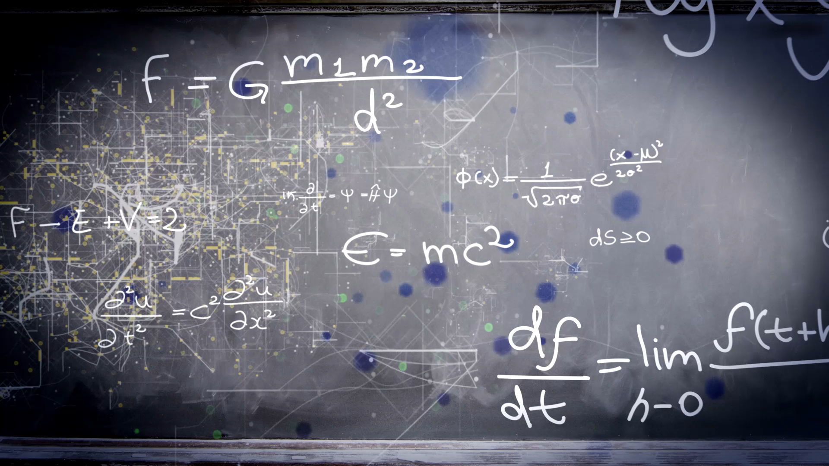
Numerical methods for solving differential Equations
(With Programming Component)

Slide 2
Team-22
Madhavarapu Revanth
Devanabanda Praneeth
Pasurla Seetha Raghavendra Kumar Reddy

Slide 3
Introduction
We can come across many problems in the world of science and technology can be formulated into differential equations. But only some of them can be solved analytically. For those which cannot be solved analytically we use numerical methods to solve them approximately.
Also, with the help of machines that reduce the burden of solving these methods are of now have great importance.
Sometimes we cannot solve a differential equation such that we cannot be able to write explicitly the dependent variable in terms of functions of independent variable. This is when where numerical methods become very useful.

Slide 4
Introduction(continued)
All the methods we described further in slides are discussed by considering the differential equation to be first order though they can be used for higher order ones.
Also, the problem we are going to solve is of obviously initial value problem type.
We are going to discuss methods such as forward, backward Euler, Midpoint, Taylor, Heun, Runge-Kutta, Adams.

Slide 5
Eulers method

Slide 6
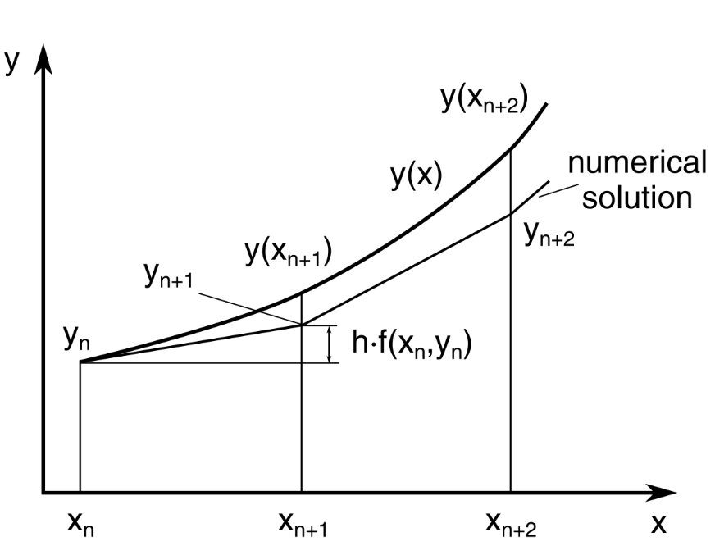
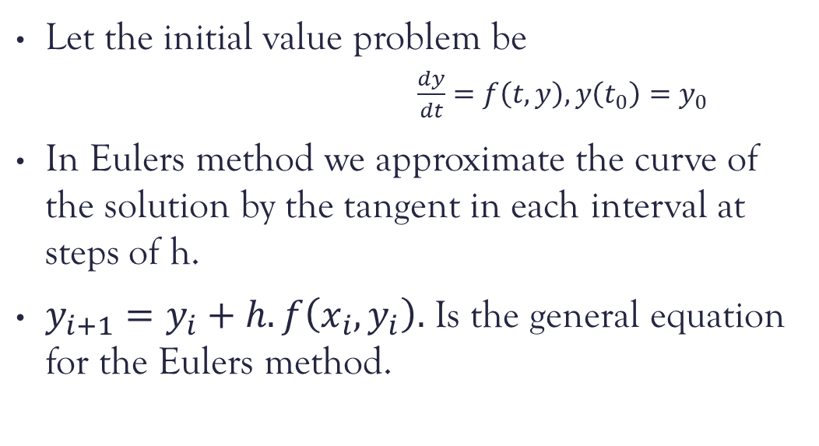
Eulers method
Let the initial value problem be
$\frac{dy}{dt}=f\left(t, y\right), y\left(t_{0}\right)=y_{0}$
In Eulers method we approximate the curve of the solution by the tangent in each interval at steps of h.
$y_{i+1}=y_{i}+h.f\left(x_{i},y_{i}\right).$ Is the general equation for the Eulers method.

Slide 7
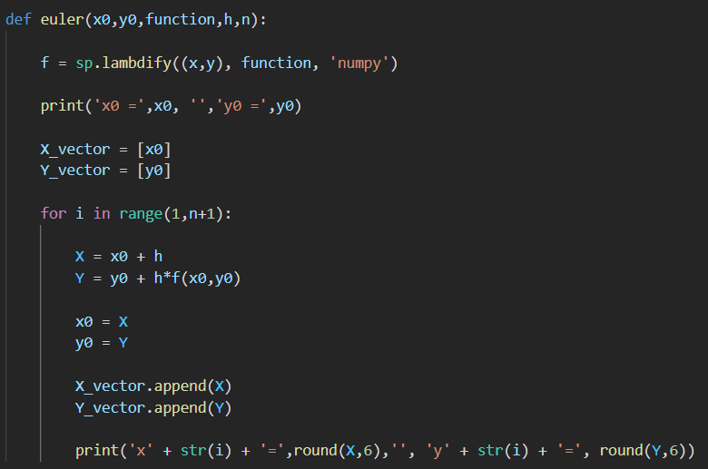
Eulers method(Code)

Slide 8



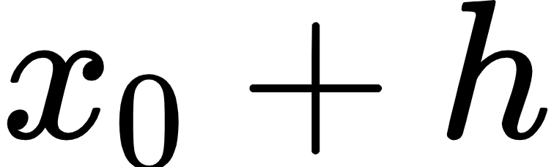
Euler’s Method code(contd)
Here the main part of the Eulers method lies in the main loop.
Here we compute the value of with the use of the function
And the store the in the NumPy array and change the values of to
This loop continues for the value of (n or h) we provided, and finally with
the stored NumPy array values we plot the Euler estimation

Slide 9
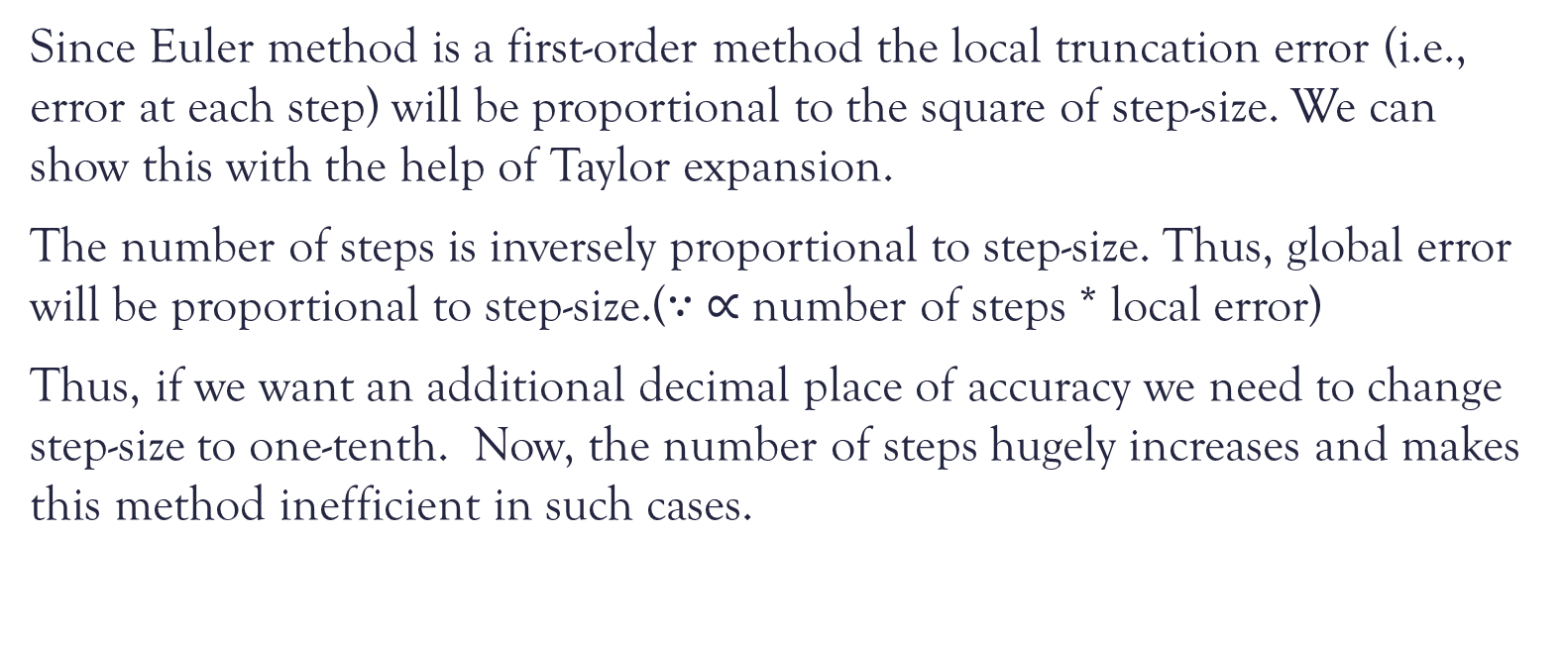
Error analysis
Since Euler method is a first-order method the local truncation error (i.e., error at each step) will be proportional to the square of step-size. We can show this with the help of Taylor expansion.
The number of steps is inversely proportional to step-size. Thus, global error will be proportional to step-size.($∵ ∝$ number of steps * local error)
Thus, if we want an additional decimal place of accuracy we need to change step-size to one-tenth. Now, the number of steps hugely increases and makes this method inefficient in such cases.

Slide 10
Backward Euler mEthod

Slide 11
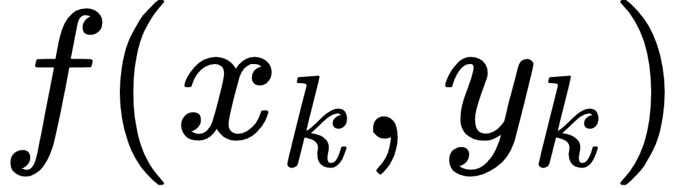
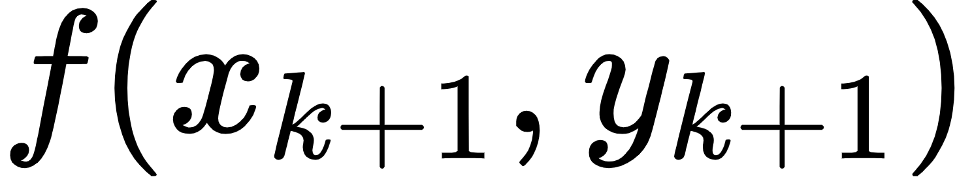

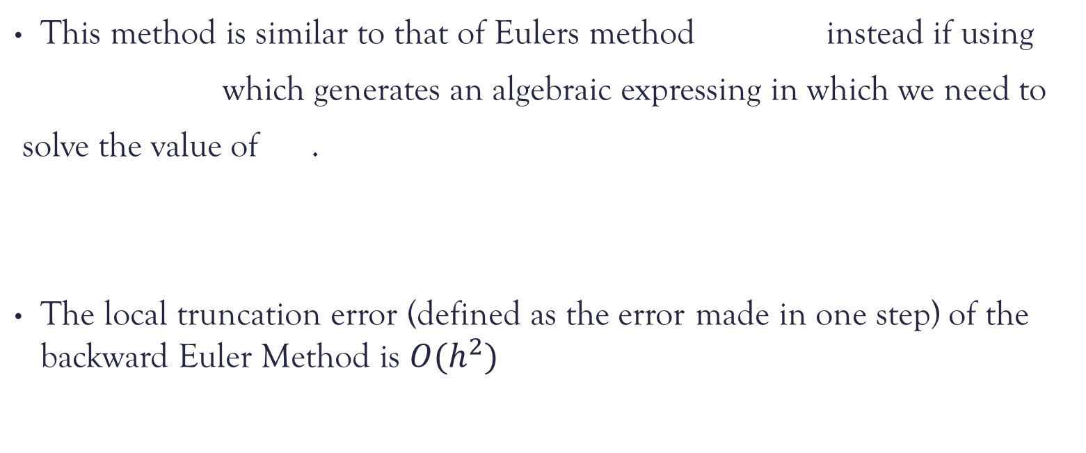
Backward Euler method
This method is similar to that of Eulers method instead if using
which generates an algebraic expressing in which we need to
solve the value of .
The local truncation error (defined as the error made in one step) of the backward Euler Method is $O(h^{2})$

Slide 12
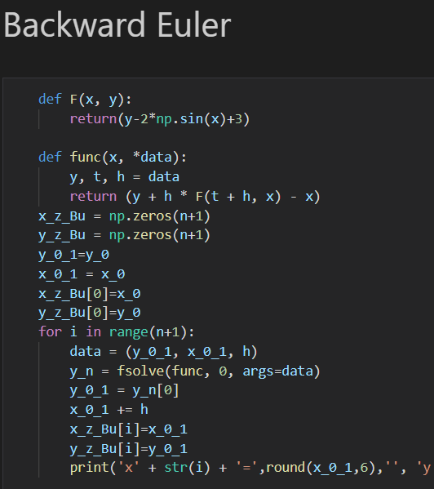
Backward Euler method
Using fsolve to calculate the y_n and storing it in the NumPy array

Slide 13
Heun method

Slide 14
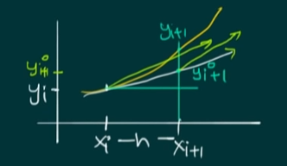
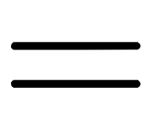
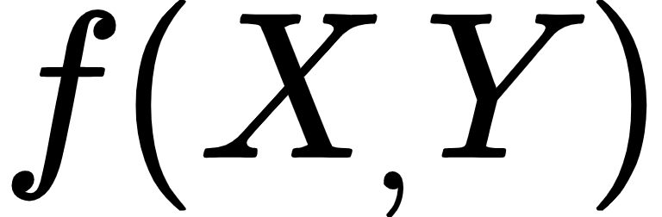
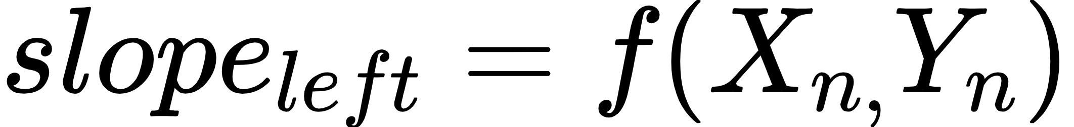
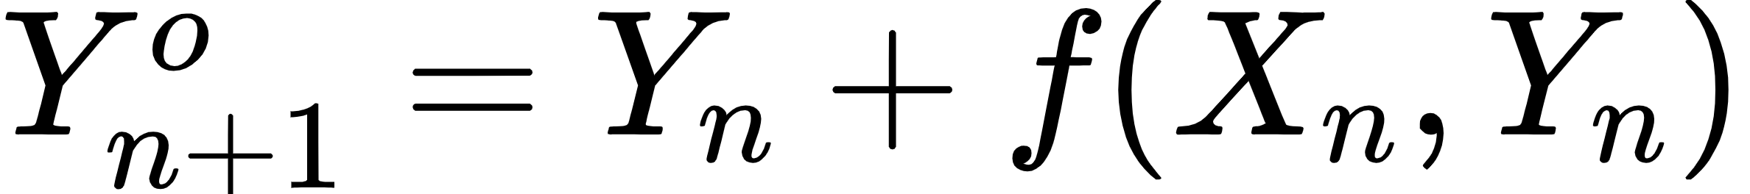

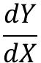
Basic Idea
Although Euler’s method is of historical interest, it is inaccurate and slow. Heun’s method slightly improves this inaccuracy.
By Euler’s method,
Now,
In Huen’s method,
Improved/Updated
$$\frac{dY}{dX}$$

Slide 15
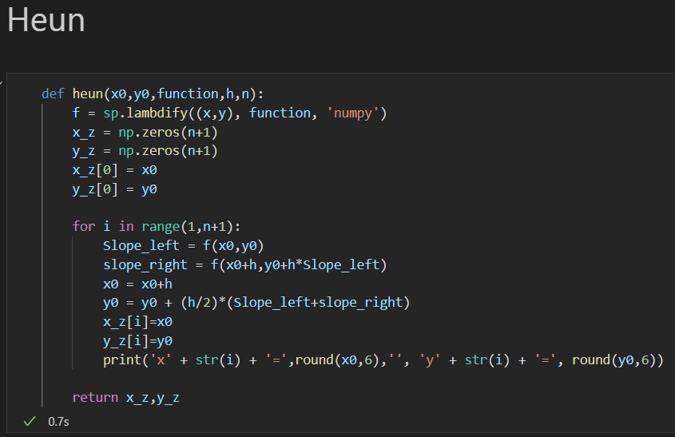
Programming Algorithm

Slide 16
Midpoint Method

Slide 17
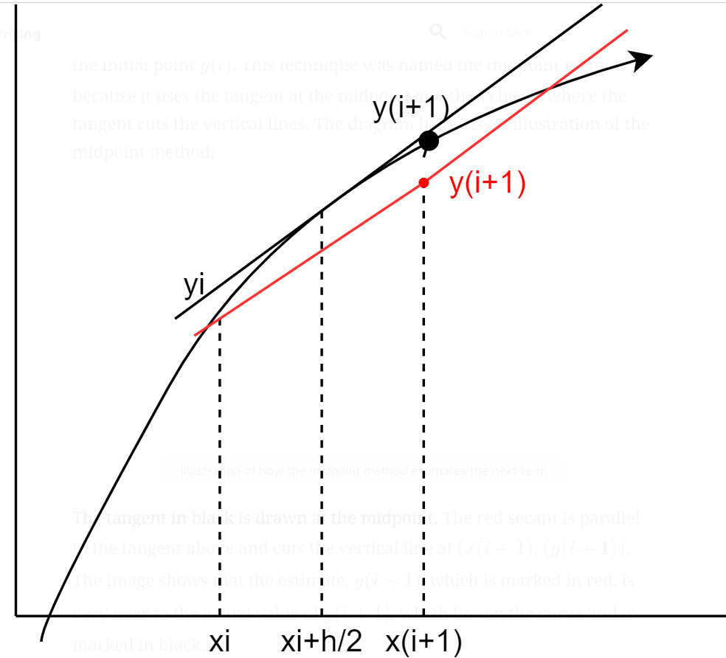
Midpoint Method
Midpoint method is similar to that of Rungekutta second order method
It uses the tangent at the midpoint and then checks where the tangent cuts the vertical lines. It is black line here(contd.)

Slide 18
Midpoint Method
The redline is parallel to the tangent above and cuts at x(i+1),y(i+1) to the vertical at x(i+1)
This method estimates Red y(i+1) which is near to that of y(i+1)

Slide 19
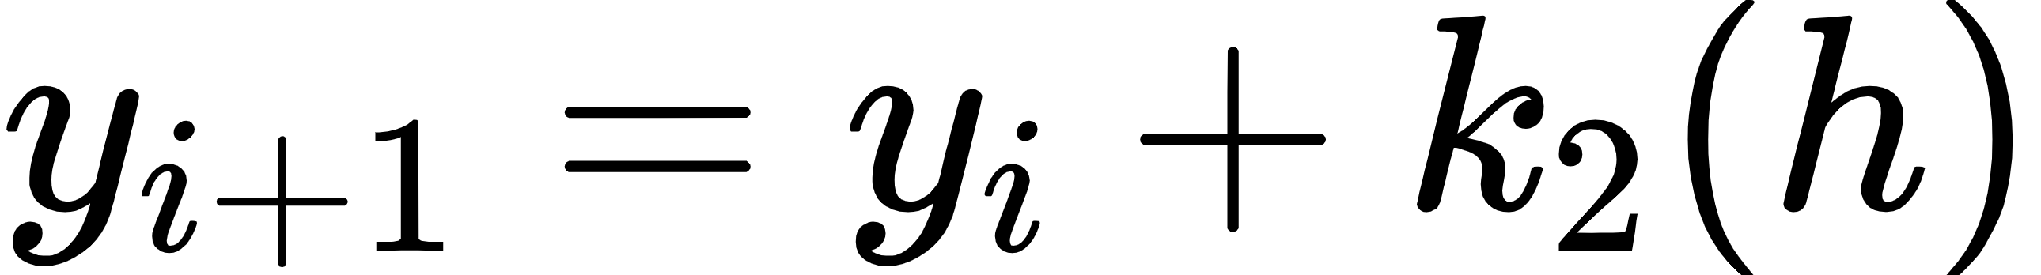
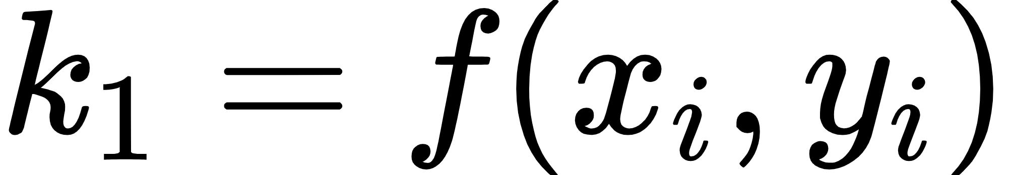
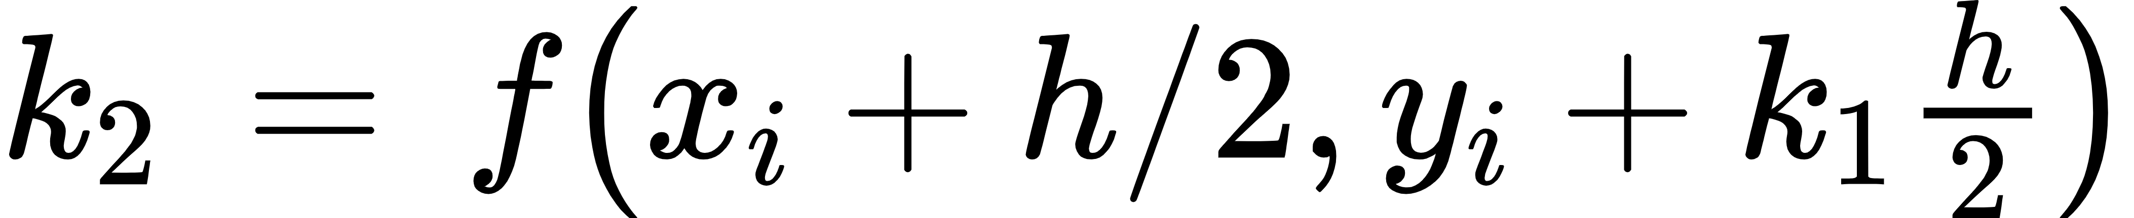
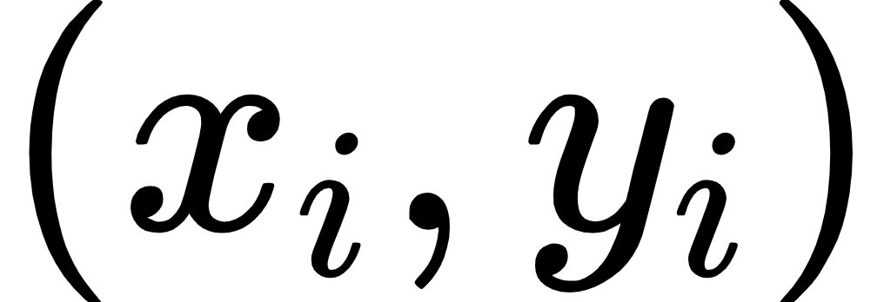
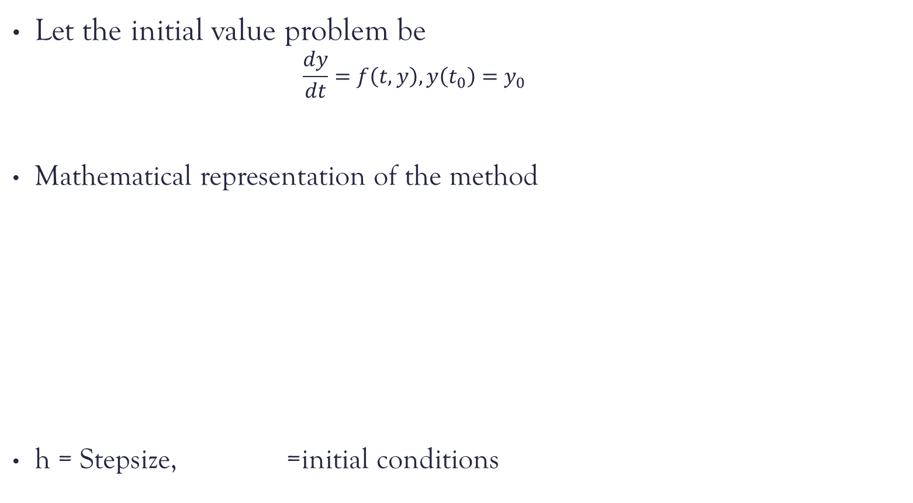
Midpoint Method
Let the initial value problem be
$$\frac{dy}{dt}=f\left(t, y\right), y\left(t_{0}\right)=y_{0}$$
Mathematical representation of the method
h = Stepsize, =initial conditions

Slide 20
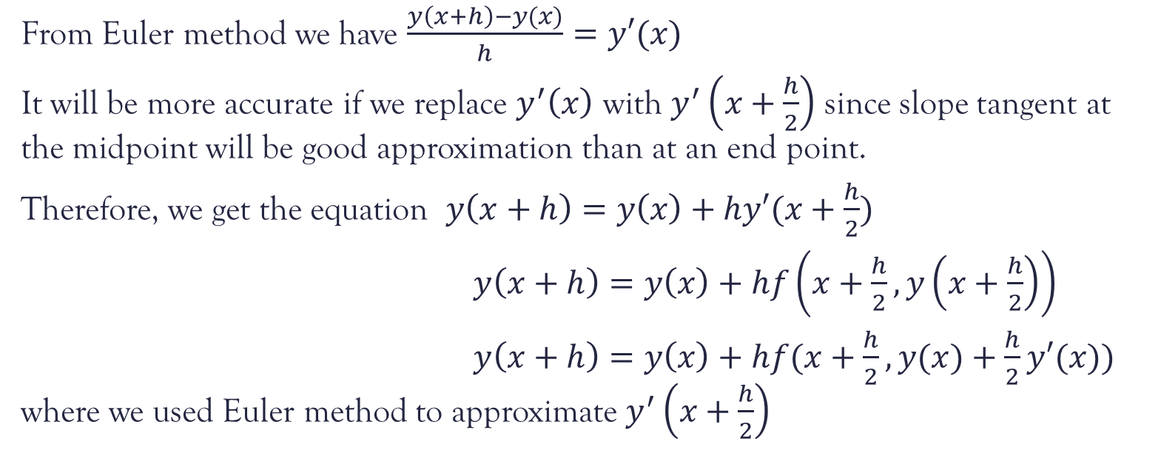
Derivation
From Euler method we have $\frac{y\left(x+h\right)−y(x)}{h}=y′(x)$
It will be more accurate if we replace $y^{′}\left(x\right)$ with $y^{′}\left(x+\frac{h}{2}\right)$ since slope tangent at the midpoint will be good approximation than at an end point.
Therefore, we get the equation $y\left(x+h\right)=y\left(x\right)+hy′(x+\frac{h}{2})$
$y\left(x+h\right)=y\left(x\right)+hf\left(x+\frac{h}{2}, y\left(x+\frac{h}{2}\right)\right)$
$y\left(x+h\right)=y\left(x\right)+hf(x+\frac{h}{2}, y(x)+\frac{h}{2}y′(x))$ where we used Euler method to approximate $y^{′}\left(x+\frac{h}{2}\right)$

Slide 21
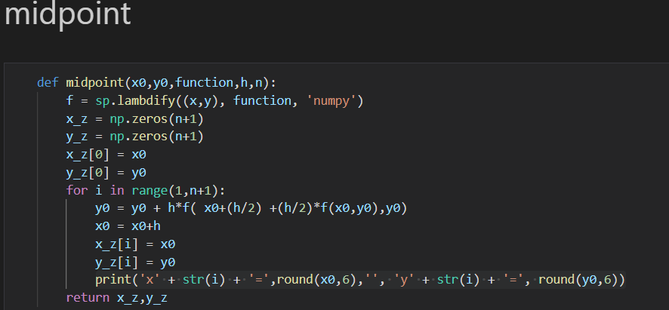
Midpoint Method(Code)
As explained in above here in the main loop we are calculation k1, k2 which is directly passed in the function f here.
With that we get y values and we store them in NumPy array similar to that of Eulers method.

Slide 22
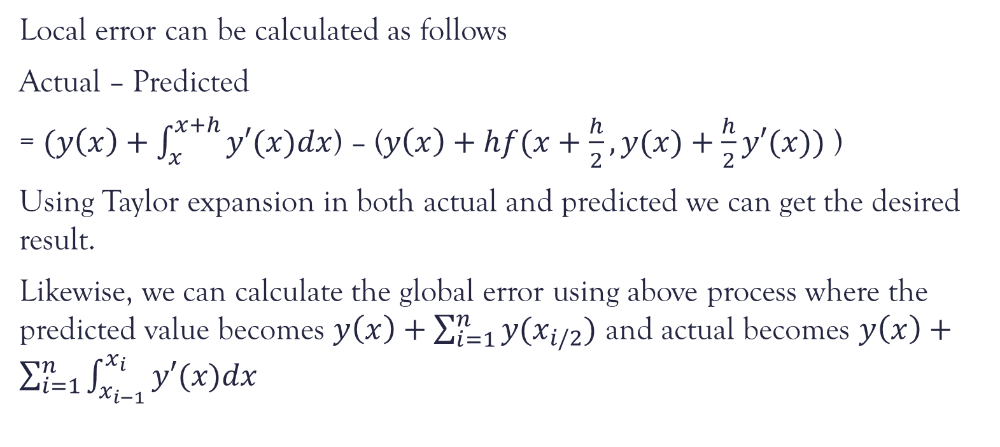
Error analysis
Local error can be calculated as follows
Actual – Predicted
= $(y\left(x\right)+\int_{x}^{x+h}{y′(x)dx}$) – ($y\left(x\right)+hf(x+\frac{h}{2}, y(x)+\frac{h}{2}y′(x))$ )
Using Taylor expansion in both actual and predicted we can get the desired result.
Likewise, we can calculate the global error using above process where the predicted value becomes $y\left(x\right)+\sum_{i=1}^{n}{y(x_{i/2}})$ and actual becomes $y\left(x\right)+\sum_{i=1}^{n}{\int_{x_{i−1}}^{x_{i}}{y′(x)dx} }$

Slide 23
Taylors Method

Slide 24
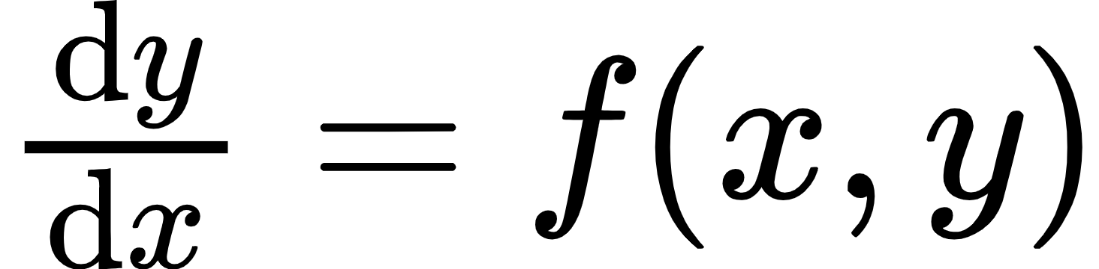
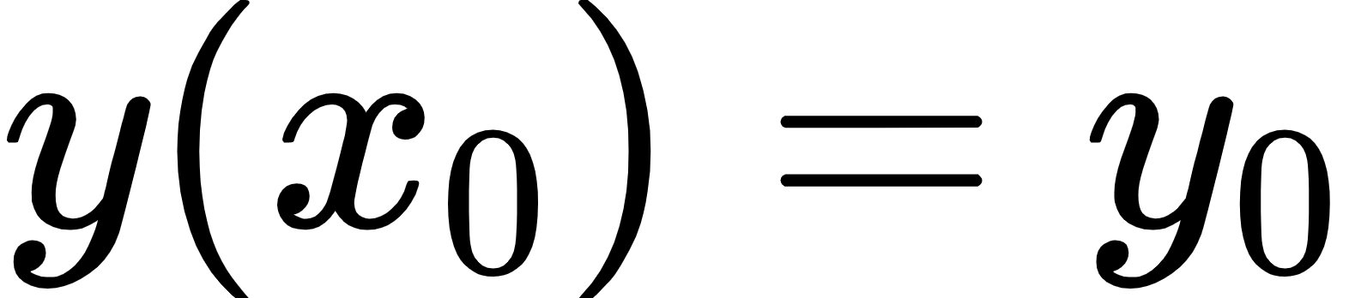
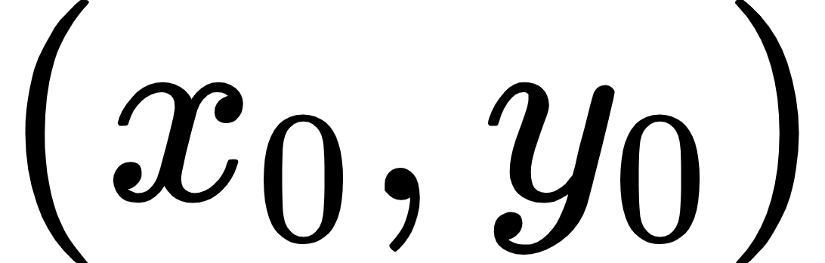

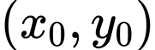

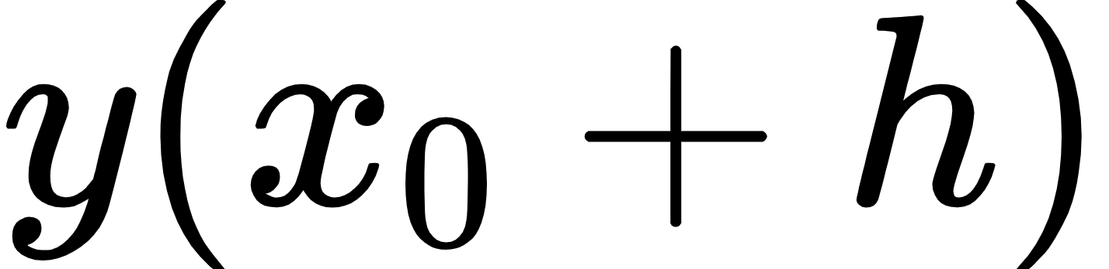
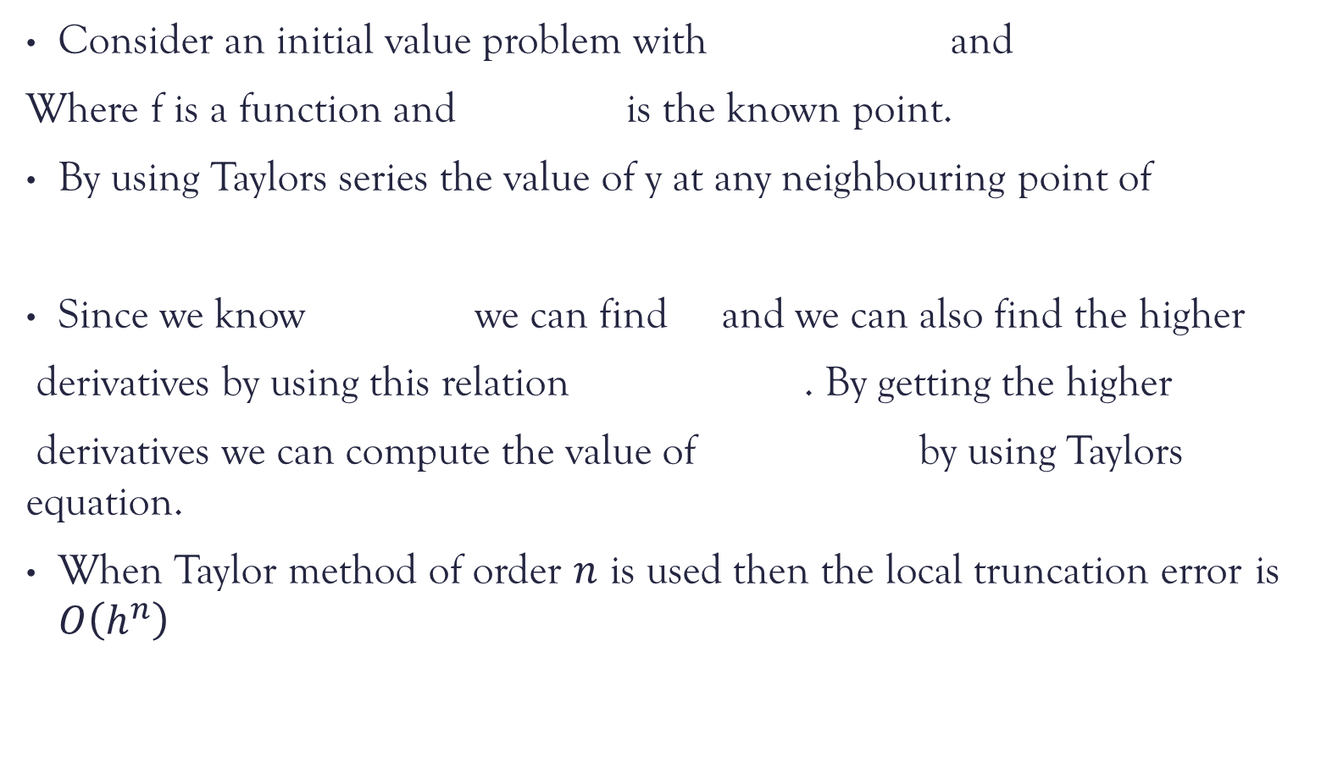
Taylors method
Consider an initial value problem with and
Where f is a function and is the known point.
By using Taylors series the value of y at any neighbouring point of
Since we know we can find and we can also find the higher
derivatives by using this relation . By getting the higher
derivatives we can compute the value of by using Taylors equation.
When Taylor method of order $n$ is used then the local truncation error is $O\left(h^{n}\right)$

Slide 25
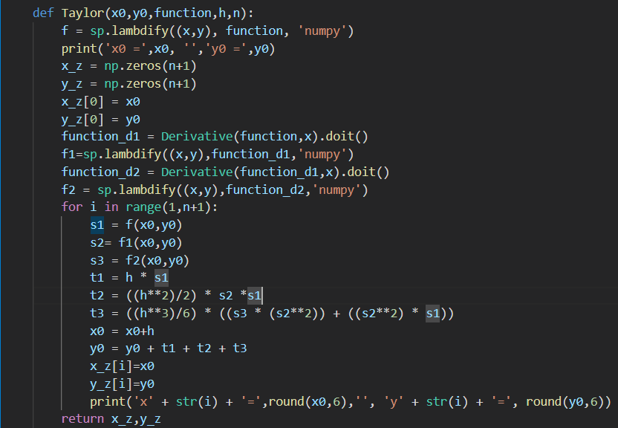
Taylors method
In the implementation of the code Taylors expansion is considered up to three terms and all the higher order derivate terms is not considered.
The major drawback of the Taylor method is it needs higher order derivatives

Slide 26
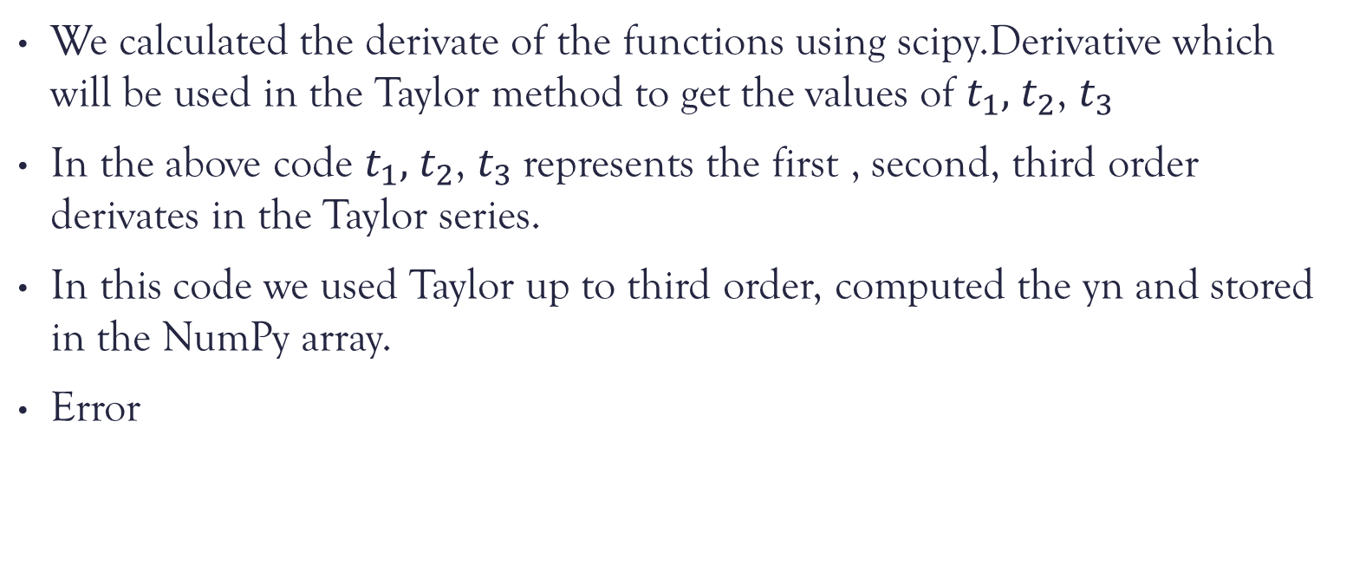
Taylors method
We calculated the derivate of the functions using scipy.Derivative which will be used in the Taylor method to get the values of $t_{1},$ $t_{2}$, $t_{3}$
In the above code $t_{1},$ $t_{2}$, $t_{3}$represents the first , second, third order derivates in the Taylor series.
In this code we used Taylor up to third order, computed the yn and stored in the NumPy array.
Error

Slide 27
Runge-Kutta methods
We have seen that the Taylor’s method requires derivatives of higher order which can be very tough task to find. Runge-Kutta method gives higher accuracy and can be done without calculating higher order derivatives and only require first order derivatives at some particular points.

Slide 28
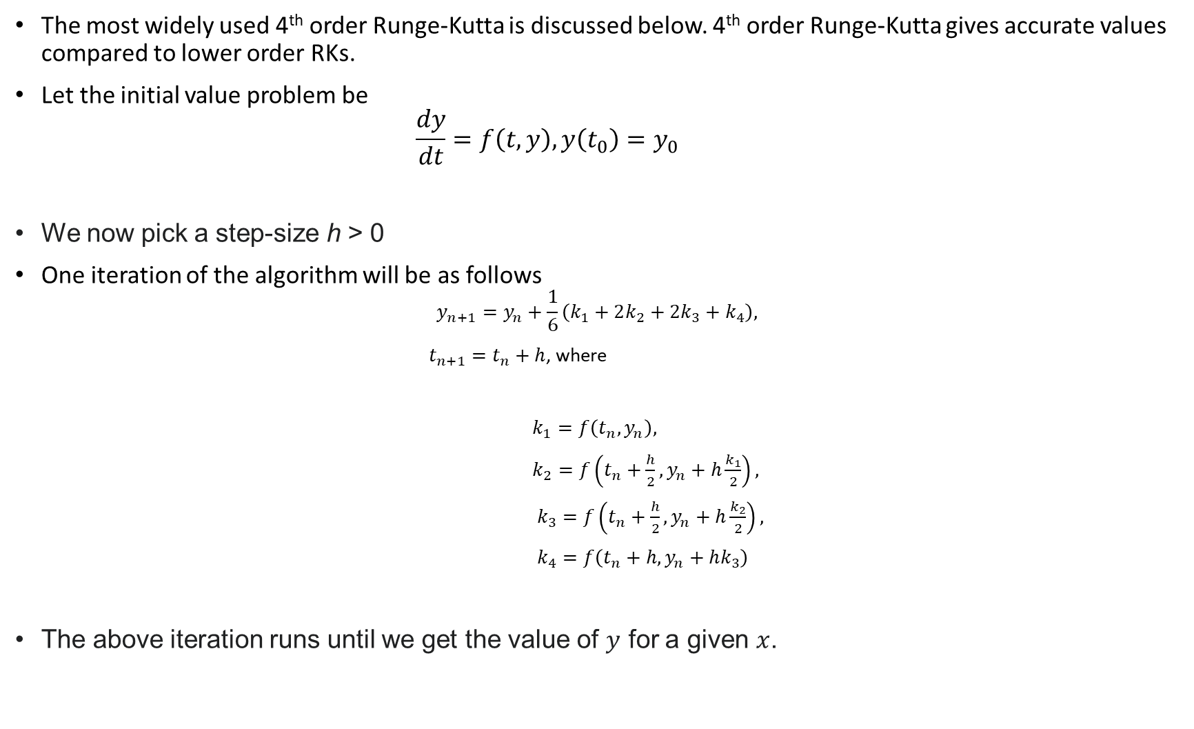
d
The most widely used 4th order Runge-Kutta is discussed below. 4th order Runge-Kutta gives accurate values compared to lower order RKs.
Let the initial value problem be
$$\frac{dy}{dt}=f\left(t, y\right), y\left(t_{0}\right)=y_{0}$$
We now pick a step-size h > 0
One iteration of the algorithm will be as follows
$$y_{n+1}=y_{n}+\frac{1}{6}\left(k_{1}+2k_{2}+2k_{3}+k_{4}\right),$$
$t_{n+1}=t_{n}+h$, where
$k_{1}=f\left(t_{n},y_{n}\right),$
$k_{2}=f\left(t_{n}+\frac{h}{2},y_{n}+h\frac{k_{1}}{2}\right),$
$k_{3}=f\left(t_{n}+\frac{h}{2},y_{n}+h\frac{k_{2}}{2}\right),$
$k_{4}=f\left(t_{n}+h,y_{n}+hk_{3}\right)$
The above iteration runs until we get the value of $y$ for a given $x$.

Slide 29
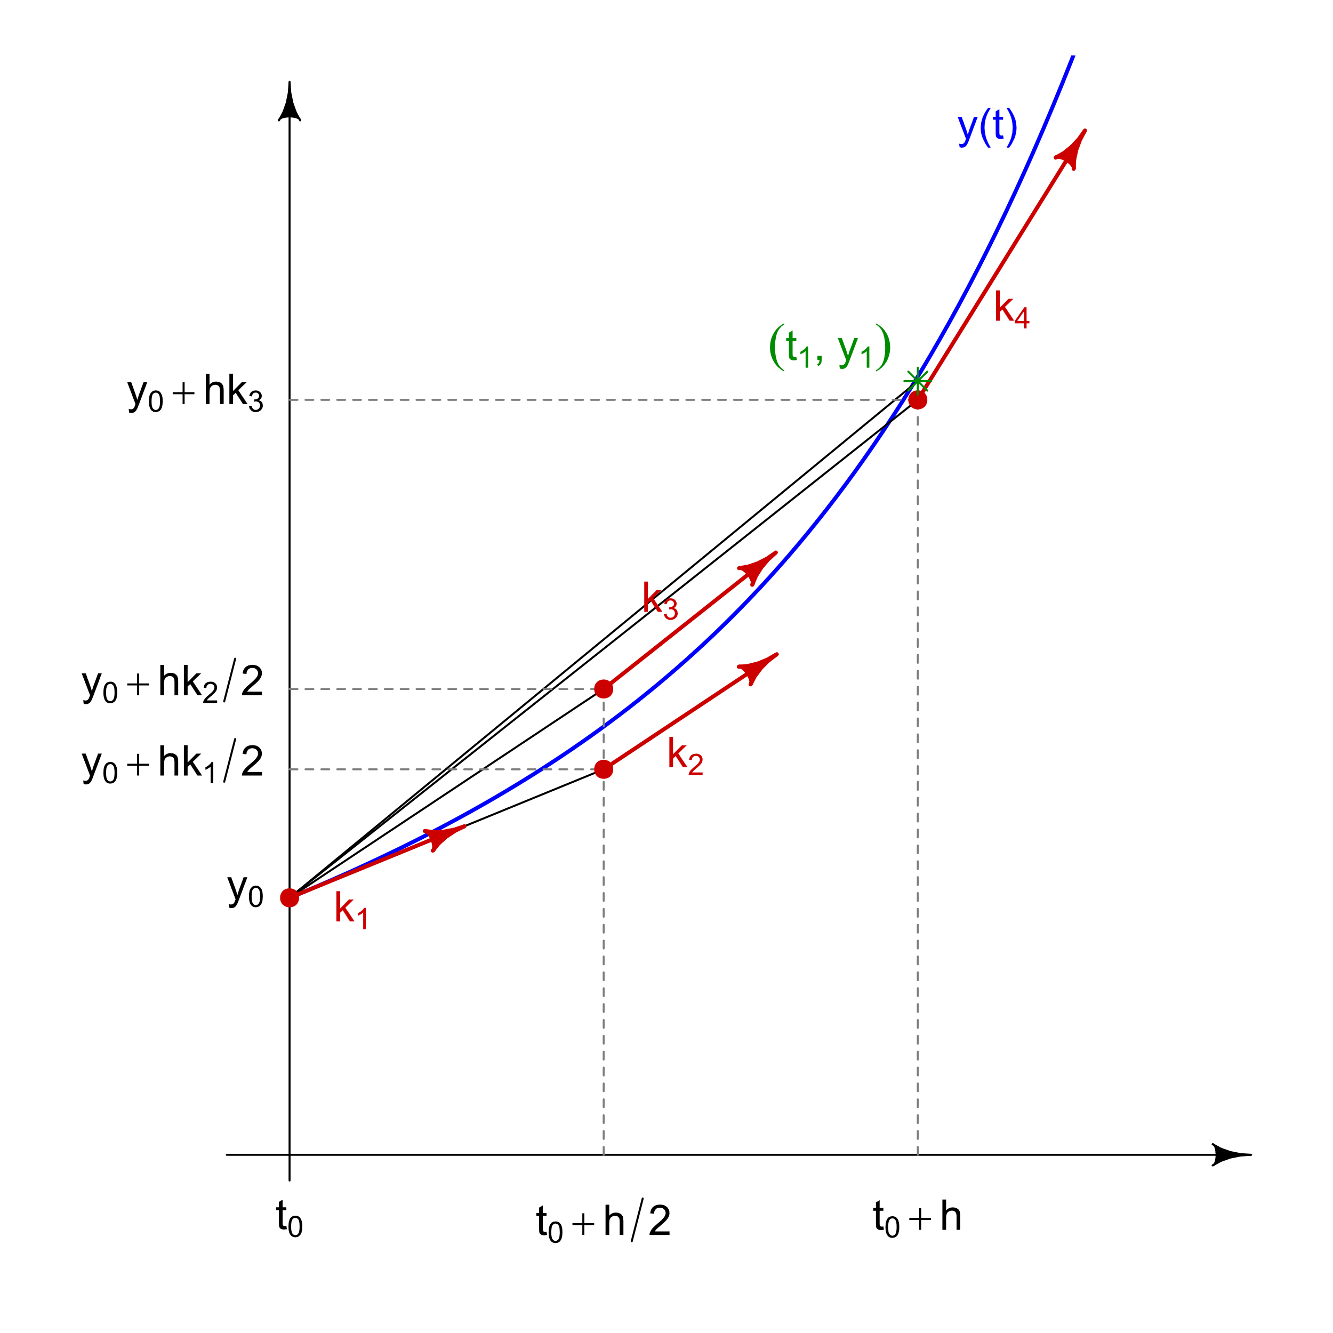
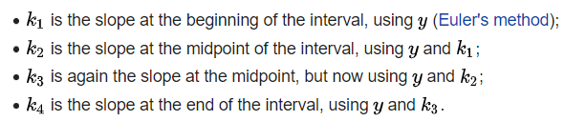
f

Slide 30
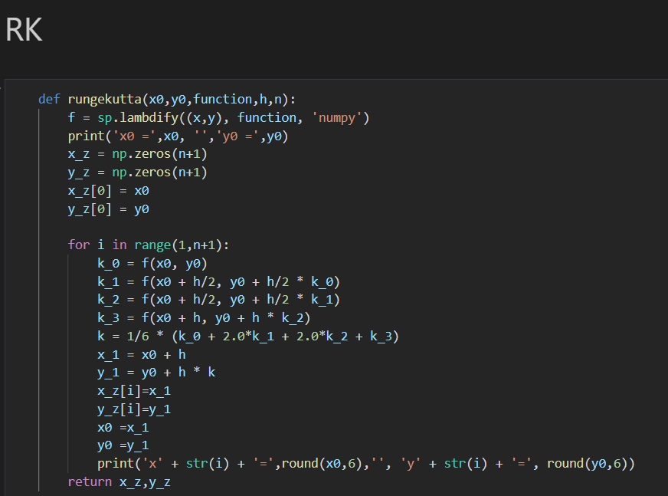
Runge kutta(algorithm)

Slide 31
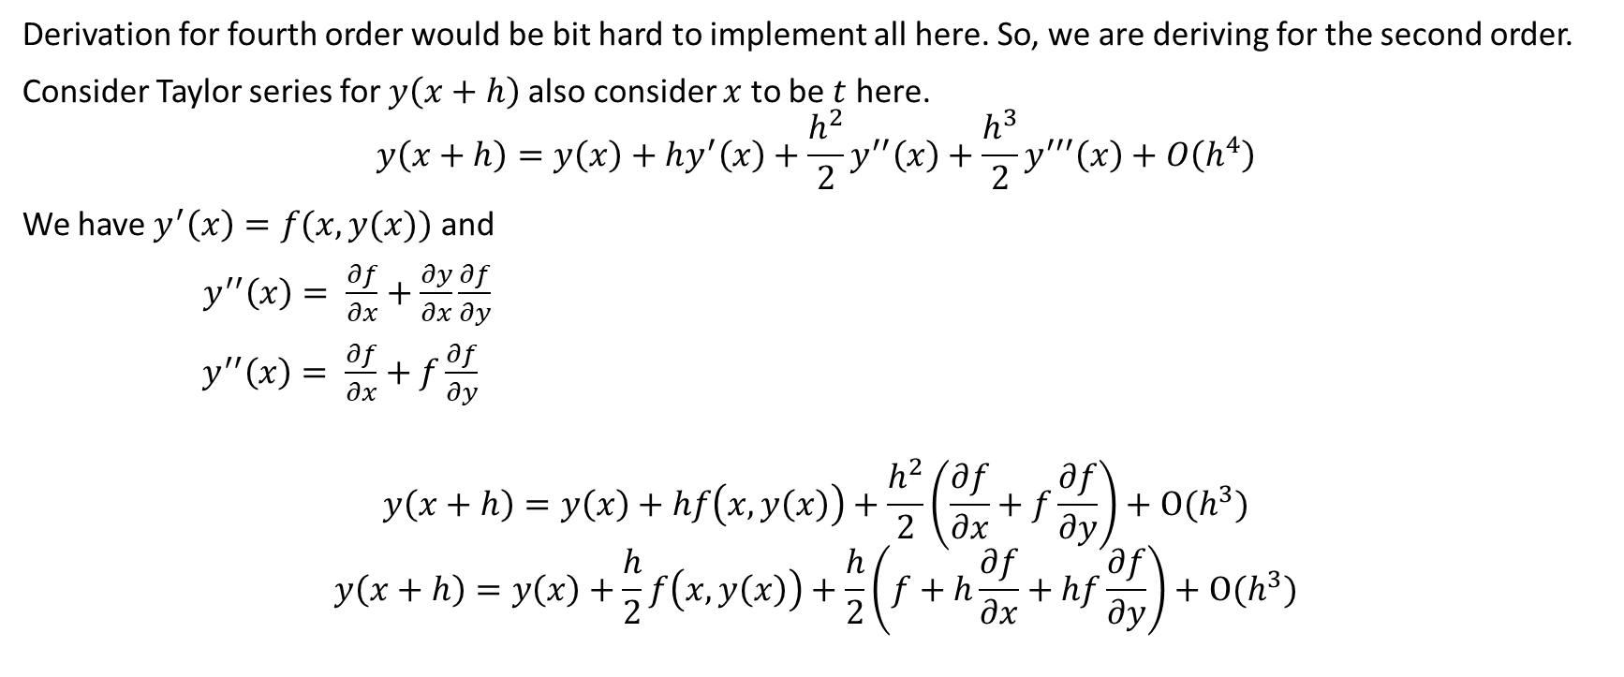
Derivation for second order Runge-Kutta
Derivation for fourth order would be bit hard to implement all here. So, we are deriving for the second order.
Consider Taylor series for $y\left(x+h\right)$ also consider $x$ to be $t$ here.
$$y\left(x+h\right)=y\left(x\right)+hy^{′}\left(x\right)+\frac{h^{2}}{2}y^{′′}\left(x\right)+\frac{h^{3}}{2}y^{′′′}\left(x\right)+O\left(h^{4}\right)$$
We have $y^{′}\left(x\right)=f(x, y(x))$ and
$y^{′′}\left(x\right)= \frac{∂f}{∂x}+\frac{∂y}{∂x}\frac{∂f}{∂y}$
${ y}^{′′}\left(x\right)= \frac{∂f}{∂x}+f\frac{∂f}{∂y}$
$$y\left(x+h\right)=y\left(x\right)+hf\left(x, y\left(x\right)\right)+\frac{h^{2}}{2}\left(\frac{∂f}{∂x}+f\frac{∂f}{∂y}\right)+O(h^{3})$$
$$y\left(x+h\right)=y\left(x\right)+\frac{h}{2}f\left(x, y\left(x\right)\right)+\frac{h}{2}\left(f+h\frac{∂f}{∂x}+hf\frac{∂f}{∂y}\right)+O(h^{3})$$

Slide 32
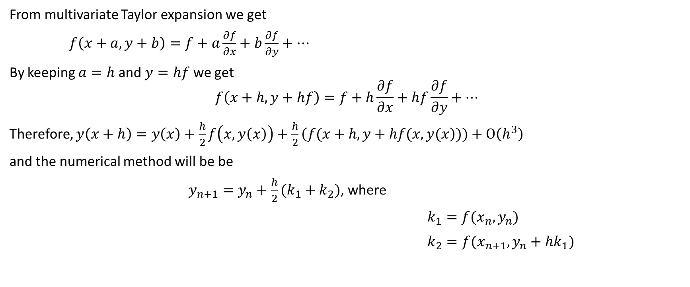
Derivation (continued)
From multivariate Taylor expansion we get
$f\left(x+a, y+b\right)=f+a\frac{∂f}{∂x}+b\frac{∂f}{∂y}+…$
By keeping $a=h$ and $y=hf$ we get
$$f\left(x+h, y+hf\right)=f+h\frac{∂f}{∂x}+hf\frac{∂f}{∂y}+…$$
Therefore, $y\left(x+h\right)=y\left(x\right)+\frac{h}{2}f\left(x, y\left(x\right)\right)+\frac{h}{2}\left(f(x+h, y+hf(x, y(x\right)))+O\left(h^{3}\right)$
and the numerical method will be be
$y_{n+1}=y_{n}+\frac{h}{2}(k_{1}+k_{2})$, where
$k_{1}=f(x_{n},y_{n})$
$k_{2}=f(x_{n+1},y_{n}+hk_{1})$

Slide 33
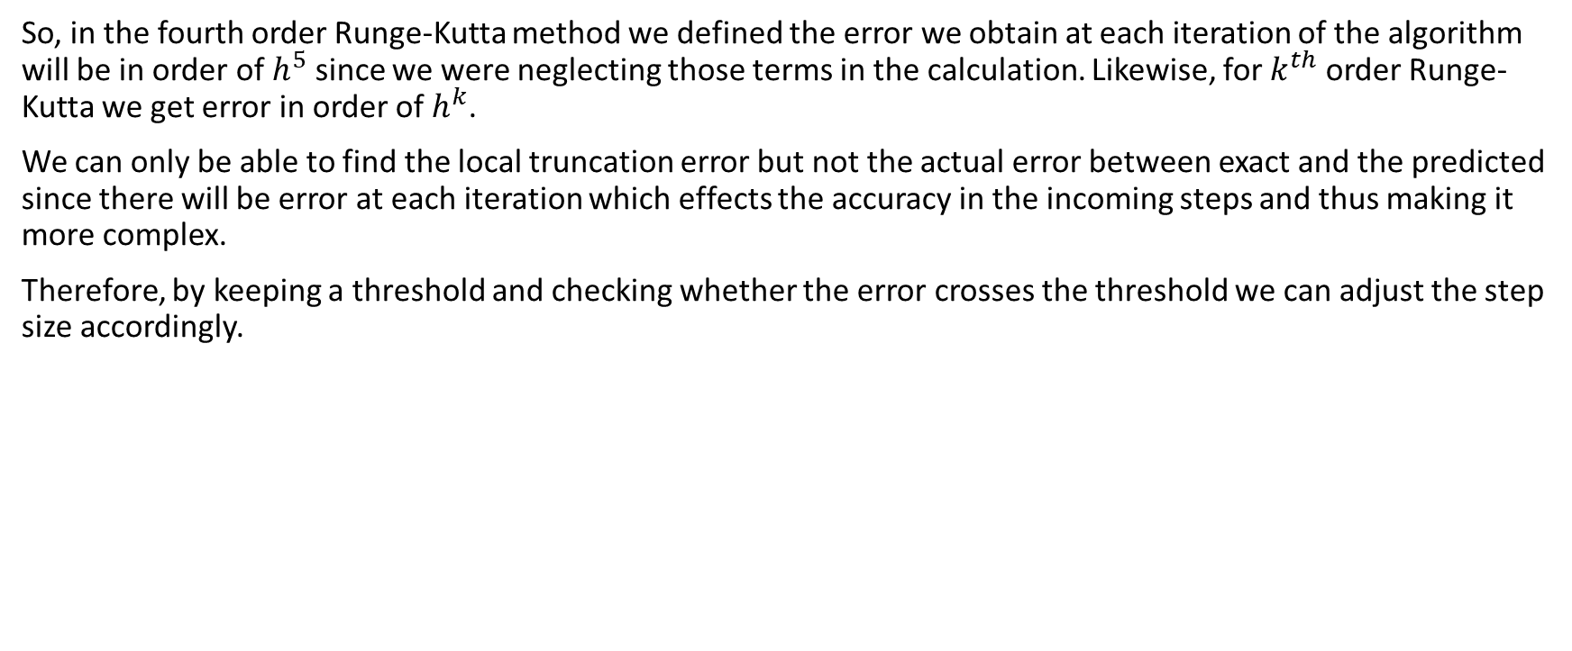
Error Analysis
So, in the fourth order Runge-Kutta method we defined the error we obtain at each iteration of the algorithm will be in order of $h^{5}$ since we were neglecting those terms in the calculation. Likewise, for $k^{th}$ order Runge-Kutta we get error in order of $h^{k}$.
We can only be able to find the local truncation error but not the actual error between exact and the predicted since there will be error at each iteration which effects the accuracy in the incoming steps and thus making it more complex.
Therefore, by keeping a threshold and checking whether the error crosses the threshold we can adjust the step size accordingly.

Slide 34
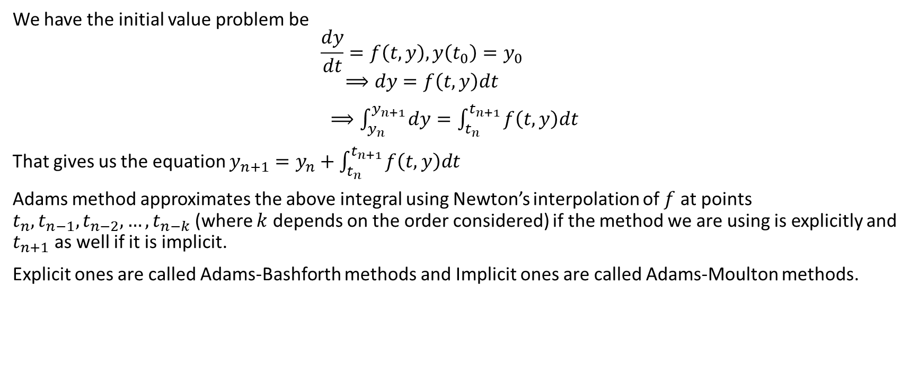
Adams Method
We have the initial value problem be
$$\frac{dy}{dt}=f\left(t, y\right), y\left(t_{0}\right)=y_{0}$$
$$⟹dy=f\left(t, y\right)dt$$
$⟹\int_{y_{n}}^{y_{n+1}}{dy}=\int_{t_{n}}^{t_{n+1}}{f\left(t, y\right)dt}$
That gives us the equation $y_{n+1}=y_{n}+\int_{t_{n}}^{t_{n+1}}{f\left(t, y\right)dt}$
Adams method approximates the above integral using Newton’s interpolation of $f$ at points $t_{n},t_{n−1},t_{n−2}, …,t_{n−k}$ (where $k$ depends on the order considered) if the method we are using is explicitly and $t_{n+1}$ as well if it is implicit.
Explicit ones are called Adams-Bashforth methods and Implicit ones are called Adams-Moulton methods.

Slide 35
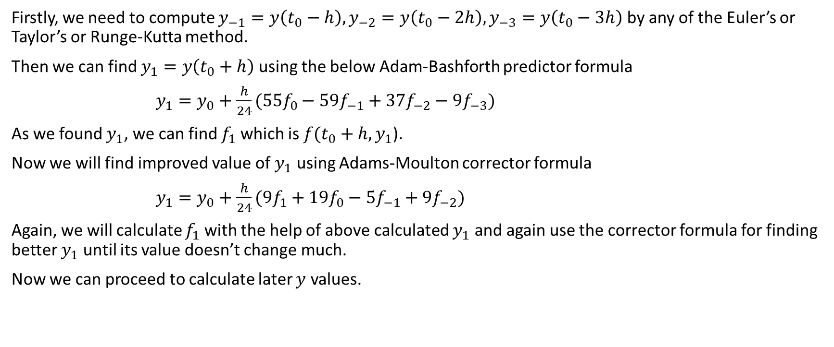
Adams Method
Firstly, we need to compute $y_{−1}=y\left(t_{0}−h\right),y_{−2}=y\left(t_{0}−2h\right),y_{−3}=y\left(t_{0}−3h\right)$ by any of the Euler’s or Taylor’s or Runge-Kutta method.
Then we can find $y_{1}=y\left(t_{0}+h\right)$ using the below Adam-Bashforth predictor formula
$y_{1}=y_{0}+\frac{h}{24}(55f_{0}−59f_{−1}+37f_{−2}−9f_{−3})$
As we found $y_{1}$, we can find $f_{1}$ which is $f(t_{0}+h,y_{1}$).
Now we will find improved value of $y_{1}$ using Adams-Moulton corrector formula
$y_{1}=y_{0}+\frac{h}{24}(9f_{1}+19f_{0}−5f_{−1}+9f_{−2})$
Again, we will calculate $f_{1}$ with the help of above calculated $y_{1}$ and again use the corrector formula for finding better $y_{1}$ until its value doesn’t change much.
Now we can proceed to calculate later $y$ values.

Slide 36
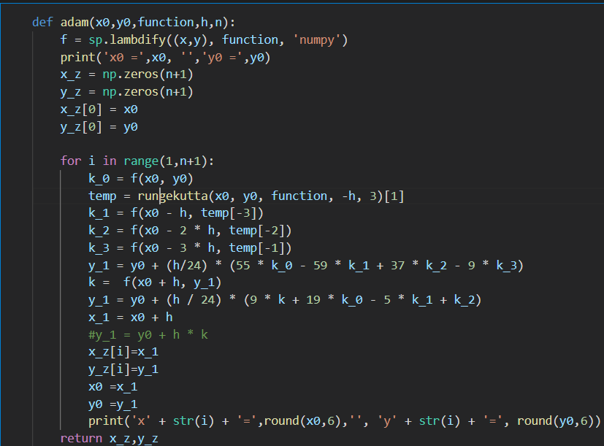
Adams method(Algorithm)

Slide 37
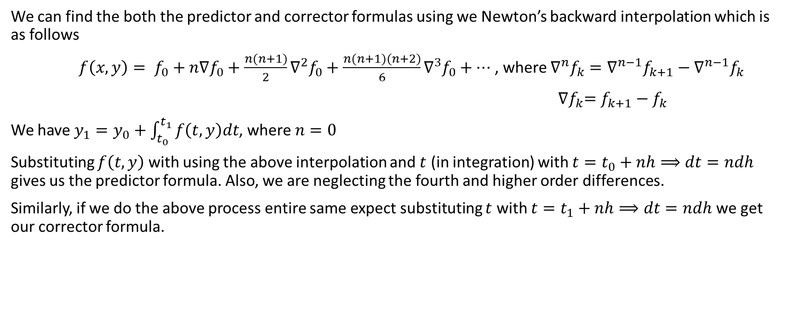
Derivation
We can find the both the predictor and corrector formulas using we Newton’s backward interpolation which is as follows
$f\left(x, y\right)= f_{0}+n∇f_{0}+\frac{n(n+1)}{2}{∇^{2}f}_{0}+\frac{n(n+1)(n+2)}{6}{∇^{3}f}_{0}+…$ , where ${∇^{n}f}_{k}={∇^{n−1}f}_{k+1}−{∇^{n−1}f}_{k}$
${∇f}_{k}=f_{k+1}−f_{k}$
We have $y_{1}=y_{0}+\int_{t_{0}}^{t_{1}}{f\left(t, y\right)dt}$, where $n=0$
Substituting $f\left(t, y\right)$ with using the above interpolation and $t$ (in integration) with $t=t_{0}+nh⟹dt=ndh$ gives us the predictor formula. Also, we are neglecting the fourth and higher order differences.
Similarly, if we do the above process entire same expect substituting $t$ with $t=t_{1}+nh⟹dt=ndh$ we get our corrector formula.

Slide 38
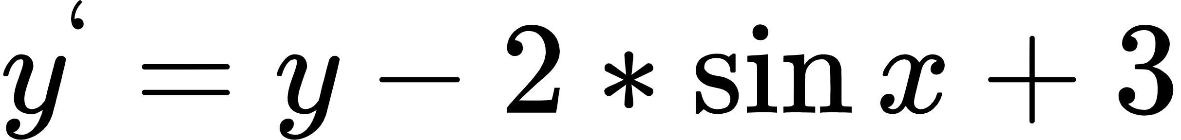
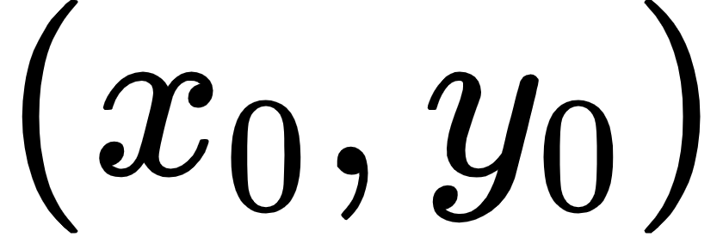
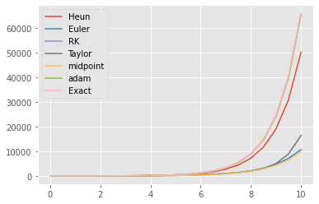
Comparison of all the methods
For the first example we used this equation with
Parameters = (0,0) and h=0.5 and n = 20.
For the exact we are using Scipy
Solver ODEINT function which is the
Reference here for the comparison of
the other methods . RK gave the best
Result coinciding with the Exact with
The higher h value

Slide 39
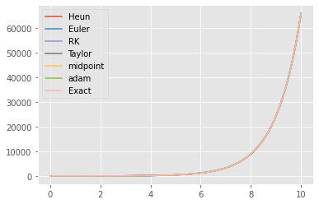
Comparison of all the methods
As we know decreasing in the h value should result in the best estimation of every numerical method here we used h=0.005 then the comparison is as shown below.
As expected all the methods gave
Exact result. As we can see all the
Graphs have coincided showing every
Numerical method will give Nearly
Exact solution if h is low enough

Slide 40
Thank you
Github

